Slide 1
3X+1讨论班极值组合报告
——on the structure of Union-closed Family

Slide 2
Abstract:
A brief look back to union-closed family conjecture
Main Methods and Results
Comparison
4. Reference

Slide 3
1.A brief introduction to union-closed family conjecture .
● In combinatorial mathematics, the union-closed sets conjecture is an elementary problem,
posed by Péter Frankl in 1979 and still open.
● A family of sets is said to be union-closed if the union of any two sets from the family remains in the family.
● The conjecture states:
For every finite union-closed family of finite sets, other than the family containing only the empty set,
there exists an element that belongs to at least half of the sets in the family.

Slide 4
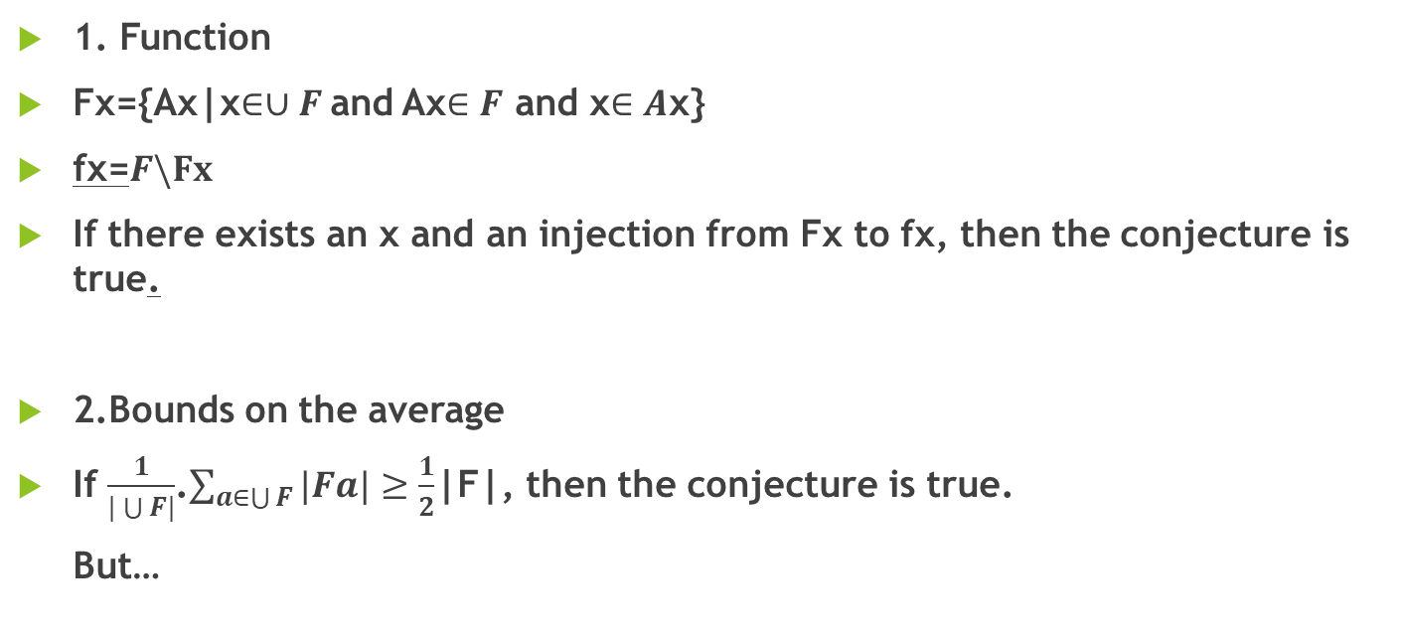
Two main tools
1. Function
Fx={Ax|x$∈∪F$and Ax$∈F$ and x$∈A$x}
fx=$F\backslash Fx$
If there exists an x and an injection from Fx to fx, then the conjecture is true.
2.Bounds on the average
If $\frac{1}{|\bigcup{F|}}$.$\sum_{a∈\bigcup{F}}{|Fa|}≥\frac{1}{2}$|F|, then the conjecture is true.
But…

Slide 5
新的研究切入点
1.半格中的极小元分解+平均值原理
2.无圈有向图（DAG）
3.偏序集的范性结构(副产品）
4.区组设计思想（未写入论文，还在探究…）
5.可证性？（未写入论文，还在探究…）
Artin不完备性： 一个具体数学对象满足一条性质可能只需要一条具体的理由，但当你的研究对象过多过复杂，那你未必能保证你能用有限种理由去说明无限的对象，此时你也不能给出一个有限的证明

Slide 6
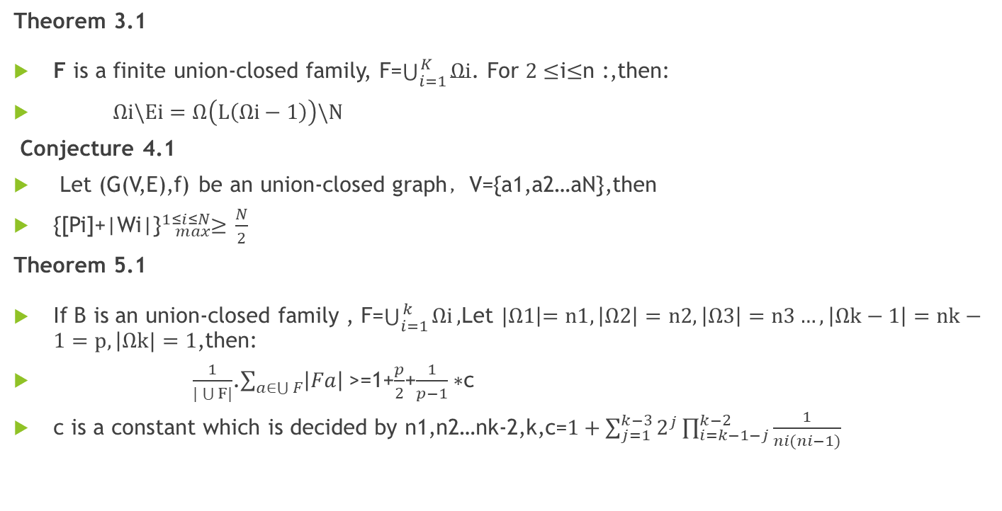
Main Results
Theorem 3.1
F is a finite union-closed family, F=$\bigcup_{i=1}^{\begin{aligned} \\ K\end{aligned}}{Ωi}$. For $2≤$i$≤$n :,then:
$Ωi\backslash Ei=Ω\left(L\left(Ωi−1\right)\right)\backslash N$
Conjecture 4.1
Let (G(V,E),f) be an union-closed graph，V={a1,a2…aN},then
{[Pi]+|Wi|}${}_{max}^{1≤i≤N}≥$ $\frac{N}{2}$
Theorem 5.1
If B is an union-closed family , F=$\bigcup_{i=1}^{\begin{aligned} \\ k\end{aligned}}{Ωi},$Let $|Ω1\left|=n1,\left|Ω2\right|=n2,\left|Ω3\right|=n3…,\left|Ωk−1\right|=nk−1=p,\right|Ωk|=1$,then:
$\frac{1}{|\bigcup{F|}}$.$\sum_{a∈\bigcup{F}}{\left|Fa\right| }$>=1+$\frac{p}{2}$+$\frac{1}{p−1}∗$c
c is a constant which is decided by n1,n2…nk-2,k,c=$1+\sum_{j=1}^{k−3}{2^{j}\prod_{i=k−1−j}^{k−2}{\frac{1}{ni(ni−1)}}}$

Slide 7
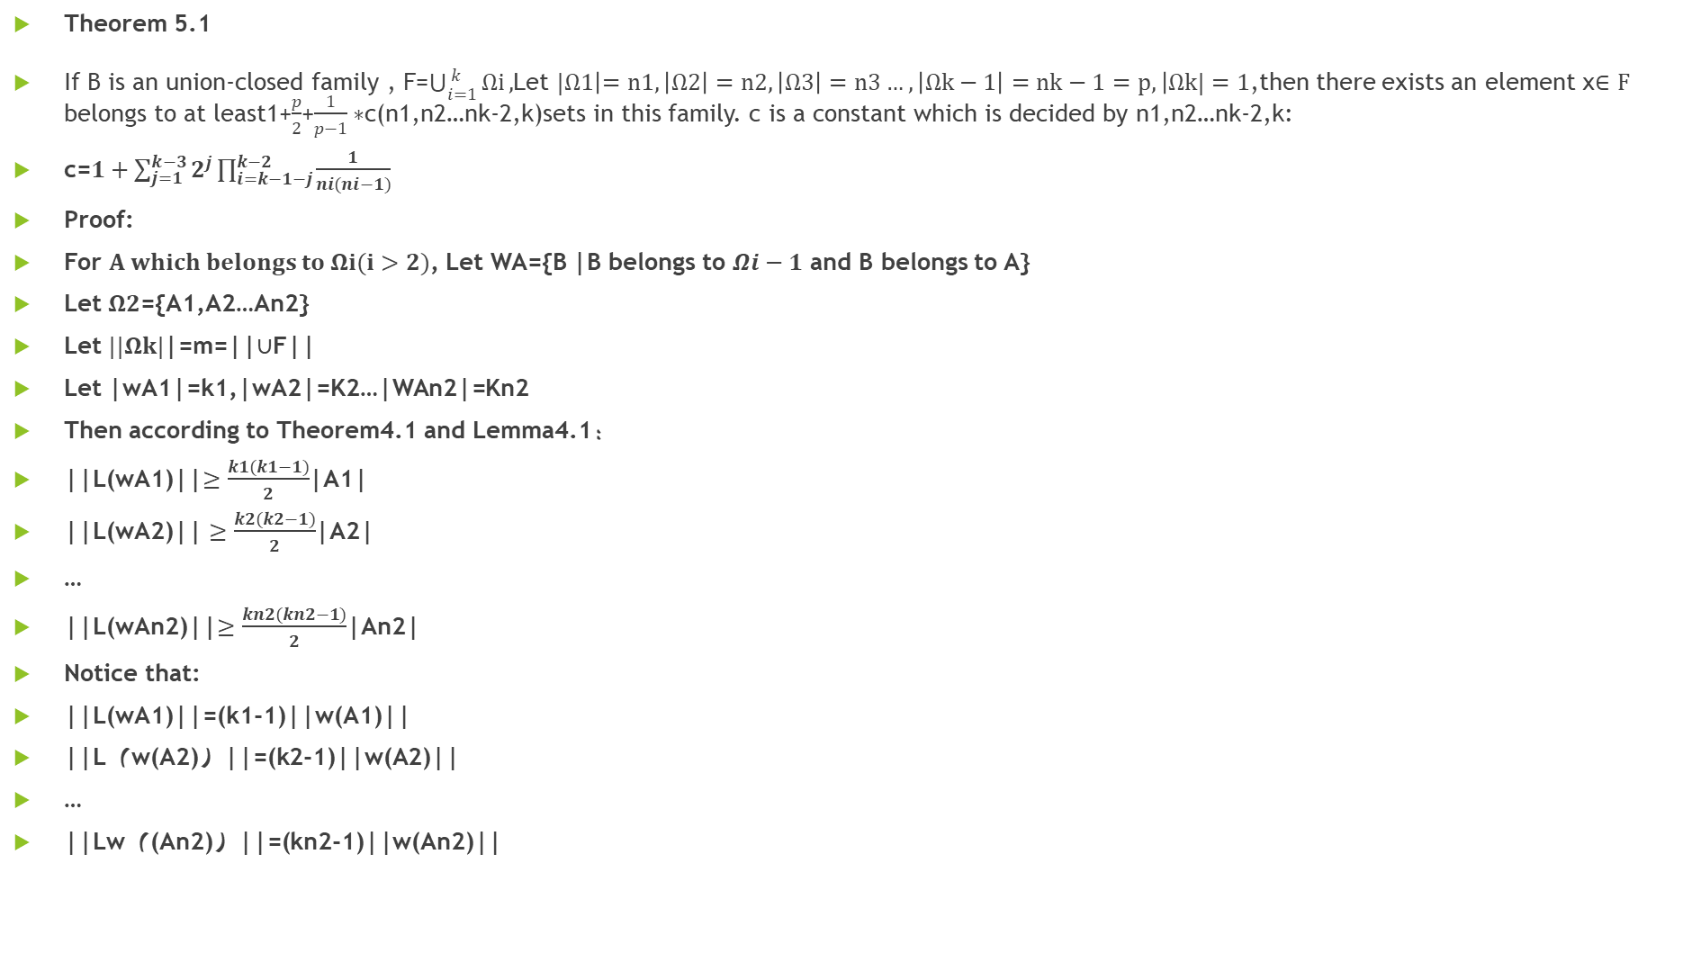
Theorem 5.1
If B is an union-closed family , F=$\bigcup_{i=1}^{\begin{aligned} \\ k\end{aligned}}{Ωi},$Let $|Ω1\left|=n1,\left|Ω2\right|=n2,\left|Ω3\right|=n3…,\left|Ωk−1\right|=nk−1=p,\right|Ωk|=1$,then there exists an element x$∈F$ belongs to at least1+$\frac{p}{2}$+$\frac{1}{p−1}∗$c(n1,n2…nk-2,k)sets in this family. c is a constant which is decided by n1,n2…nk-2,k:
c=$1+\sum_{j=1}^{k−3}{2^{j}\prod_{i=k−1−j}^{k−2}{\frac{1}{ni(ni−1)}}}$
Proof:
For $A which belongs to Ωi(i>2)$, Let WA={B |B belongs to $Ωi−1$ and B belongs to A}
Let $Ω2$={A1,A2…An2}
Let $||Ωk|$|=m=||$∪$F||
Let |wA1|=k1,|wA2|=K2…|WAn2|=Kn2
Then according to Theorem4.1 and Lemma4.1：
||L(wA1)||$≥\frac{k1(k1−1)}{2}$|A1|
||L(wA2)|| $≥\frac{k2(k2−1)}{2}$|A2|
…
||L(wAn2)||$≥\frac{kn2(kn2−1)}{2}$|An2|
Notice that:
||L(wA1)||=(k1-1)||w(A1)||
||L（w(A2)）||=(k2-1)||w(A2)||
…
||Lw（(An2)）||=(kn2-1)||w(An2)||

Slide 8
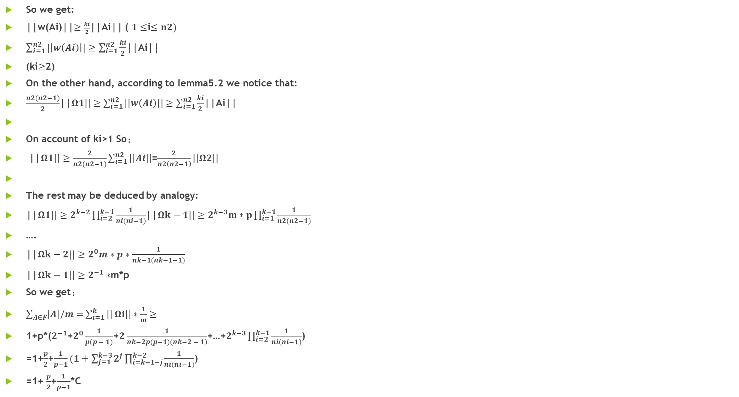
So we get:
||w(Ai)||$≥\frac{ki}{2}$||Ai|| ( $1≤$i$≤n2)$
$\sum_{i=1}^{n2}{|\left|w\left(Ai\right)\right||≥\sum_{i=1}^{n2}{\frac{ki}{2}}}$||Ai||
(ki$≥$2)
On the other hand, according to lemma5.2 we notice that:
$\frac{n2(n2−1)}{2}$||$Ω1||≥\sum_{i=1}^{n2}{|\left|w\left(Ai\right)\right||≥\sum_{i=1}^{n2}{\frac{ki}{2}}}$||Ai||
On account of ki>1 So：
||$Ω1||≥\frac{2}{n2(n2−1)}\sum_{i=1}^{n2}{|\left|Ai\right||}$=$\frac{2}{n2\left(n2−1\right)}|\left|Ω2\right||$
The rest may be deduced by analogy:
||$Ω1||≥$ $2^{k−2}\prod_{i=2}^{k−1}{\frac{1}{ni(ni−1)}}$||$Ωk−1||≥2^{k−3}m∗p\prod_{i=1}^{k−1}{\frac{1}{n2(n2−1)}}$
….
||$Ωk−2||≥2^{0}m∗p∗\frac{1}{nk−1(nk−1−1)}$
||$Ωk−1||≥2^{−1}∗$m*p
So we get：
$\sum_{A∈F}{\left|A\right|/m=}\sum_{i=1}^{k}{||}Ωi||∗\frac{1}{m}≥$
1+p*($2^{−1}$+$2^{0}\frac{1}{p(p − 1)}$+$2\frac{1}{nk−2p(p−1)(nk−2 − 1)}$+…+$2^{k−3}\prod_{i=2}^{k−1}{\frac{1}{ni(ni−1)}}$)
=1+$\frac{p}{2}$+$\frac{1}{p−1}(1+\sum_{j=1}^{k−3}{2^{j}\prod_{i=k−1−j}^{k−2}{\frac{1}{ni(ni−1)}}}$)
=1+ $\frac{p}{2}$+$\frac{1}{p−1}$*C

Slide 9
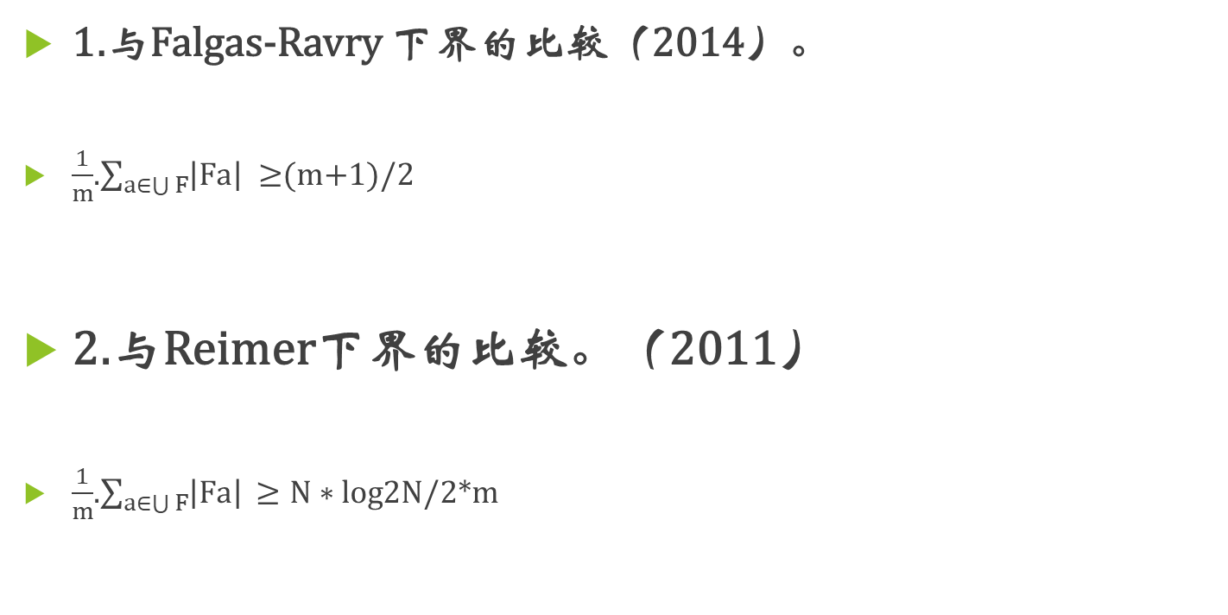
与同类结果的比较
1.与Falgas-Ravry 下界的比较（2014）。
$\frac{1}{m}$.$\sum_{a∈\bigcup{F}}{\left|Fa\right| }≥$(m+1)/2
2.与Reimer下界的比较。（2011）
$\frac{1}{m}$.$\sum_{a∈\bigcup{F}}{\left|Fa\right| }$ $≥N∗log$2N/2*m

Slide 10
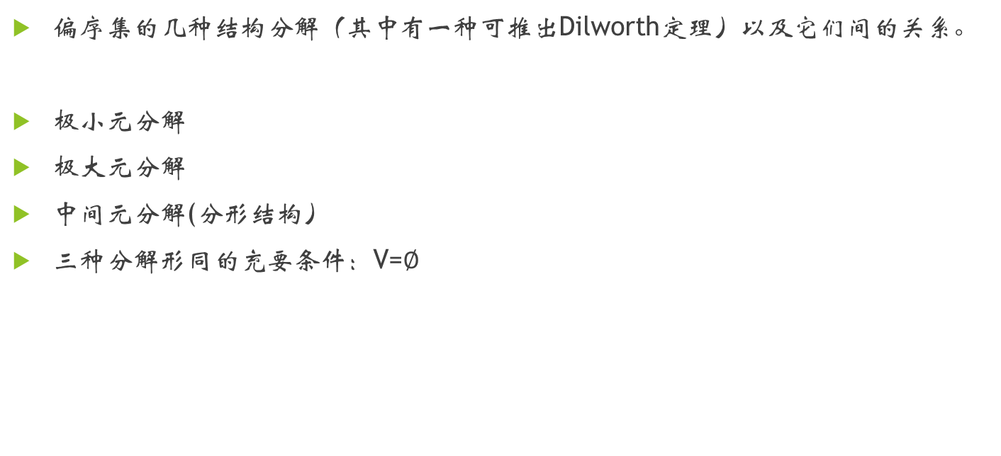
副产品
偏序集的几种结构分解（其中有一种可推出Dilworth定理）以及它们间的关系。
极小元分解
极大元分解
中间元分解(分形结构）
三种分解形同的充要条件：V=$∅$

Slide 11
References
[1] Abe, Tetsuya, Strong semimodular lattices and Frankl’s conjecture, Algebra Universalis
44 (2000), no. 3-4, 379-382.
[2] Lo Faro, Giovanni, Union-closed sets conjecture: improved bounds, J. Combin. Math.
Combin. Comput. 16 (1994), 97-102.
[3] Morris, Robert, FC-families and improved bounds for Frankl’s conjecture, European
Journal of Combinatorics 27 (2006), no. 2, 269-282.
[4] Poonen, Bjorn, Union-closed families, Journal of Combinatorial Theory, Series A 59
(1992), no. 2, 253-268.
[5] Reinhold, Jrgen, Frankl’s conjecture is true for lower semimodular lattices, Graphs
Combin. 16 (2000), no. 1, 115-116.
[6] Sarvate, D. G.; Renaud, J.-C. On the union-closed sets conjecture, Ars Combin. 27
(1989), 149-153.
[7] Wojcik, Piotr, Union-closed families of sets, Discrete Math 199 (1999), 173—182.

Slide 12
Thank you!

